Slide 1
Updated 9/26/2023
2023-24 ELPAC Interim Assessment Training
This PowerPoint is available on the Student Testing Branch Website in Coordinator Resources https://www.lausd.org/testing
This presentation will be used to facilitate your school-based training.

Slide 2
Agenda
ELPAC Interim Assessments
Interim Assessments Viewing System
Interim Assessments Hand Scoring System
School Site Professional Development Topics and Training Requirements
Creating TOMS accounts
Accessibility Resources
Student Logon Credentials
Technology
Creating Test Sessions
Monitoring Test Completion
California Educator Reporting System (CERS)

Slide 3
Training Objectives
To provide School Site ELPAC Coordinators and Designees with a comprehensive training that will enable them to guide their school in the administration of ELPAC Interim Assessments including:
Administering and Scoring the Interim Assessments
California Educator Reporting System (CERS)

Slide 4
Interim Assessments
New ELPAC Interim Assessments

Slide 5
ELPAC Interim Assessment Release Plan
Now Available—Preview Access for Educators (Set 1)
Interim assessment forms will be available in the Interim Assessment Viewing System.
Secure hand scoring materials and answer keys are available in the Test Operations Management System (TOMS).
October 19, 2023—Administration and Results Access (Set 1)
IAs will be available in the Test Delivery System (TDS) for administering to students.
Items requiring hand scoring will be available in the Teacher Hand Scoring System (THSS).
After hand scoring is completed, the following data will be available in the California Educator Reporting System (CERS):
Overall scale scores
Performance levels
Custom aggregate reports
Key and distractor analysis
Late January 2024 – Test items and student responses will be viewable in CERS.
Late July 2024 - Individual Student Reports (ISRs) will be available in CERS.

Slide 6
ELPAC Interim Assessments
IAs provide meaningful information for gauging student progress toward mastery of the skills measured by the summative assessments.
Interim assessments provide an additional opportunity to try out accessibility supports with students and actual test items to evaluate effectiveness.
The Interim Assessments can be used in multiple ways:
Support student learning
Used during daily instruction
Monitor Student Progress
Administered after a period of instruction
Used by school and district staff for professional development

Slide 7
ELPAC Interim Assessments
How an assessment is administered can impact how the data it provides should be interpreted.
Standardized Administration
Students complete the IA individually following the administration procedure used for the summative assessments.
The results can be considered an assessment of what students know.
Non standardized Administration
Students complete the IA under conditions that are not consistent with the administration requirements of the summative assessment.
Some examples of Non standardized administration might include, but are not limited to, the following:
Administering tests while students answer cooperatively in pairs, in small groups, or as a whole class

Slide 8
ELPAC Interim Assessments
Each set of ELPAC IAs have four individual domain-based tests (i.e., Listening, Speaking, Reading, and Writing).
Administered online
IAs are untimed
Developed for the following seven grade levels and grade spans:
Kindergarten
Grade 1
Grade 2
Grade span 3-5
Grade span 6-8
Grade span 9 and 10
Grade span 11 and 12

Slide 9
Interim Assessments by Grade Level
Interim Assessments At a Glance
This document lists, by grade level or grade span, all available CAASPP and ELPAC Interim Assessments.
Interim Assessments by Grade Level:
Lists the available IAs and associated standards
Total number of items on each IA
Provides the number of constructed response and essay items that require local hand scoring (by TA)

Slide 10
Interim Assessments
MMED Administration Recommendations

Slide 11
ELPAC Interim Assessments
MMED Recommendations:
Prioritize Potential Long-term ELs (PLTELs) and Long Term ELs (LTELs)
All priority schools should implement the ELPAC IA to EBs
ELs who are not making progress
Testing Window:
November through January 2024
Administration Format:
Standardized
Notes:
MMED Frame: The availability of this great resource is historic. For once, we have an interim assessment that specifically assesses our EBs’ English language fluency, which aligns to the ELPAC and the 2012 ELD standards (in listening, speaking, reading and writing). All teachers could use this interim assessment to inform Designated and Integrated ELD. No longer do schools have to spend their, limited funding to purchase ELP assessment resources that might/or not be align to the ELD standards and the ELPAC.
MMED Recommendations:
Prioritize Potential Long-term ELs (PLTELs) and Long Term ELs (LTELs) who are not making adequate progress towards reclassification as shown in their Individual Reclassification Plan
All priority (data dig) schools should implement the ELPAC IA to EBs who are not making adequate progress on the ELPAC
EBs who are not making progress on the ELPAC [as measured by the English Learner Progress Indicator (ELPI)]
Testing Window:
November through 2024, to have actionable data to optimally prepared EBs before the Summative ELPAC administration, specially EBs with ELPAC level 3.
Administration Format:
Standardized. Will support in having actionable, reliable data.

Slide 12
Interim Assessments
Viewing System

Slide 13
Interim Assessment Viewing System
Accessible through elpac.org through the Interim Assessment tab
Module 2a and 2b: Interim Assessments Viewing System and the Interim Assessments Viewing System Demonstration videos
Provide information on how to log into and navigate the Interim Assessment Viewing System.
Describe how the viewing system can be used by educators to prepare for the administration of interim assessments.
Interim Assessments Viewing System Video:
https://www.cde.ca.gov/ta/tg/sa/iavideoseries.asp
VIDEO 1
Interim Assessments Viewing System Demonstration Video:
https://www.cde.ca.gov/ta/tg/sa/iavideoseries.asp
VIDEO 2

Slide 14
Interim Assessments
Hand Scoring System

Slide 15
Teacher Hand Scoring System
Most Interim Assessment items are scored by the test delivery engine, others require hand scoring.
Hand scoring is completed by the IA Test Administrator in the Teacher Hand Scoring System (THSS).
This is the same platform where Initial ELPAC grades 3-12 Writing responses are scored.
Scoring is supported by training guides, rubrics, exemplars (i.e., anchor and practice papers) located in TOMS Resources.

Slide 16
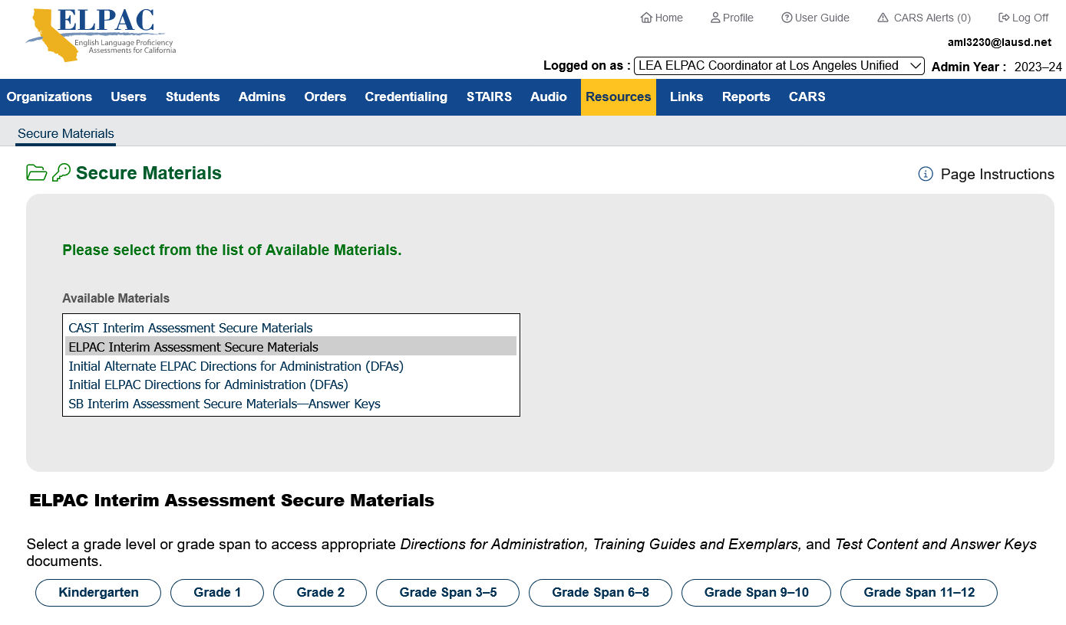
Training Guides and Exemplars
1
2
3

Slide 17
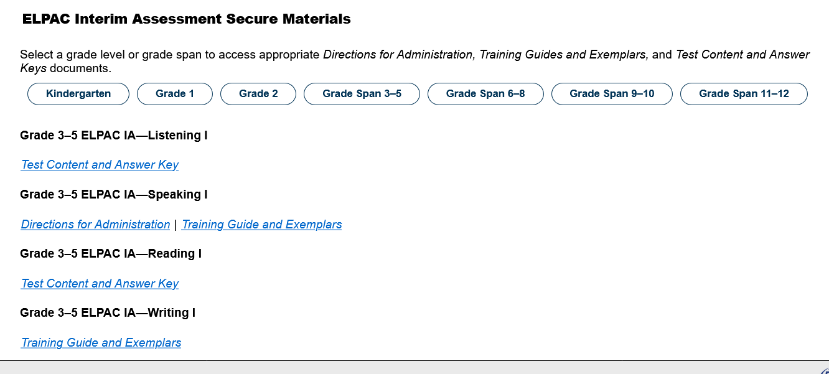
Training Guides and Exemplars
Test Content and Answer Key
Administration Script and Rubrics
Questions
Answer Keys
Score Sheets
DFA
Script and rubrics
Training Guides and Exemplars
Administration Script and Rubrics
Questions
Anchor Responses and justifications

Slide 18
Hand Scoring Video
Module 4: Interim Assessment Hand Scoring Video
Access the Interim Assessment Hand Scoring System Video through the following link:
https://www.cde.ca.gov/ta/tg/sa/iavideoseries.asp

Slide 19
Preparing for IA Administration
School Site Professional Development Topics
Training Requirements

Slide 20
School Site Professional Development Agenda
IOC on ELPAC IAs
IA Acknowledgement Form for Teachers to Sign
IA Security Reminder
IAs Available by Grade
IA Viewing System – Video
Supports and Accommodations Available –
Creating a Test Session
Standardized vs. Non Standardized
Student Logon Credentials
Hand Scoring System - Video
CERS – (California Educator Reporting System) – CERS for Educators Video
IOC on mandated assessments
Must have a dated Sign-in with each agenda.
Save Agenda and Sign-ins in school’s testing files for 2 years

Slide 21
IA Administrator Training Requirements
LAUSD Interim Assessments Acknowledgement Form (In STB Portal)
Interim Assessment Training
2023-24 ELPAC Interim Assessment Training (facilitated by ELPAC Coordinator)
Use this PowerPoint
OR
2023-24 CAASPP Fall Training (facilitated by Site CAASPP Coordinator)
ELPAC Coordinator must review the MMED guidance (IOC) regarding ELPAC IAs.

Slide 22
ELPAC IA Requirements – Proctors
2023-24 ELPAC Security Form TE and Proctor Requirements (via MyPLN)
2023-24 ELPAC Security Affidavit - electronic submission in STB Portal via MyPLN.
Must be on the LAUSD network to sign,
Interim Assessment Training
2023-24 ELPAC Interim Assessment Training (facilitated by ELPAC Coordinator)
OR
2023-24 CAASPP Fall Training (facilitated by Site CAASPP Coordinator)

Slide 23
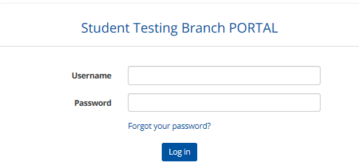
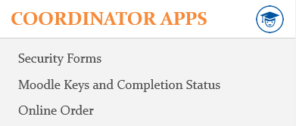
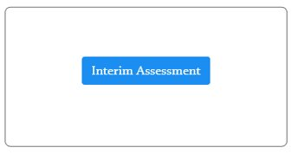
Signing the IA Acknowledgment Form
Navigate to STB Website: https://www.lausd.org/testing
1
2
3
4

Slide 24
Signing the IA Acknowledgment Form

Slide 25
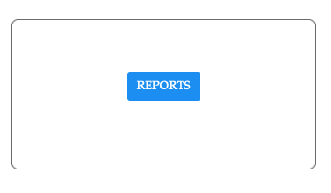
Verifying Completion of the Acknowledgement Form
Navigate to STB Website: https://www.lausd.org/testing
1
2
3
4
The report will include the names and information of all the teachers at the school site who have successfully submitted their Interim Assessment Acknowledgement Form.

Slide 26
Verifying Completion of the Acknowledgement Form
Select Interim Assessment
Select your school to view substitutes
2023-24
Verify that the Acknowledgement form was signed
TOMS accounts can be created after verifying the acknowledgement form is signed and participants have completed the school-based training.

Slide 27
Preparing for IA Administration
Creating TOMS Accounts

Slide 28
Security
Staff who are granted TOMS accounts are permitted to access secure and confidential information and resources.
Do not share account credentials with any other employee or person.
Memorize or store account logon information in a secure location; do not request computer to store or remember password.
Do not disclose or share any secure material in any format with anyone else.
Teachers who have ELPAC TE accounts or CAASPP IA-ONLY accounts will already have access to the Interim Assessments.

Slide 29
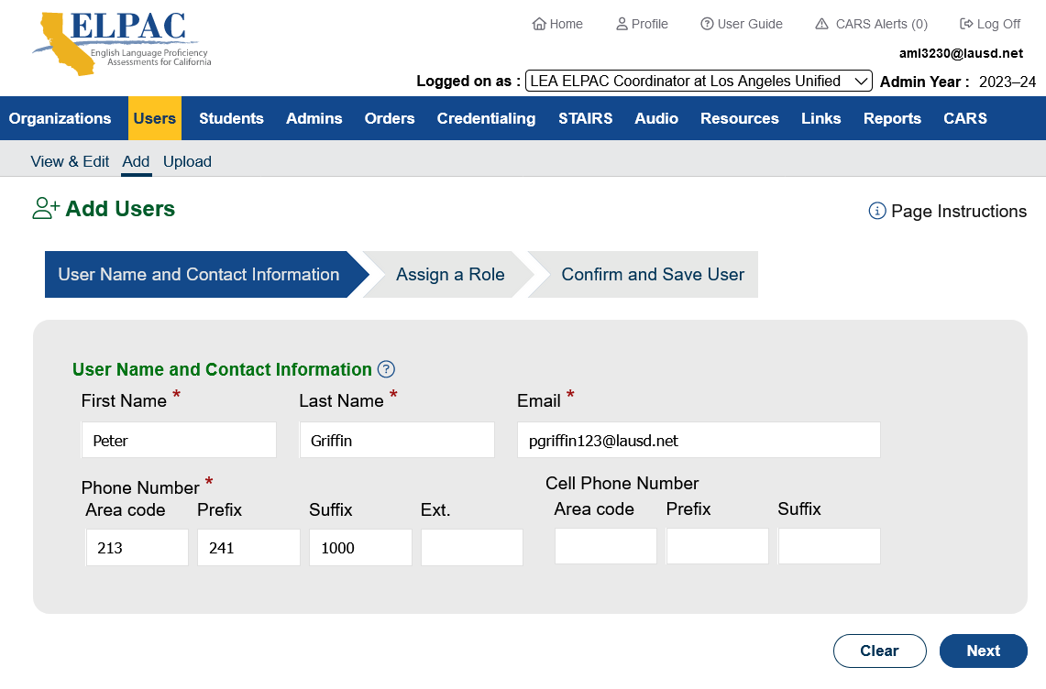
Creating IA TOMS Accounts
“ADD”
Use only LAUSD Emails
Complete all fields
Next

Slide 30
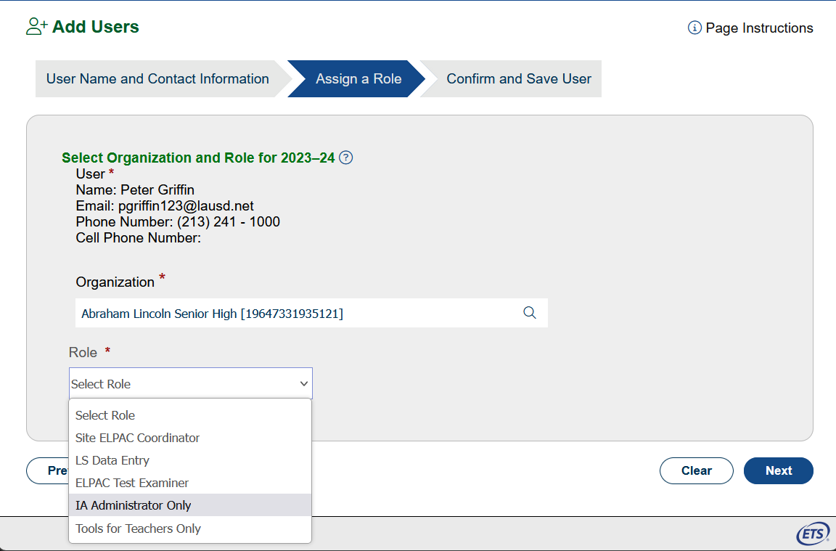
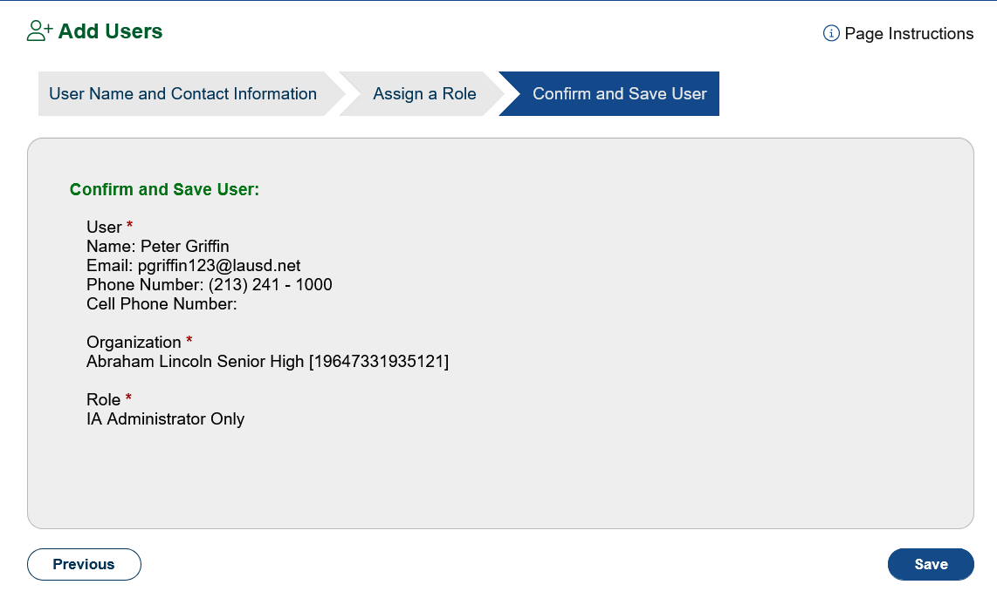
Creating IA TOMS Accounts
Confirm that all information is correct. If the email was entered incorrectly, the TE will not be able to access TOMS.
Select IA Administrator Only.
Save

Slide 31
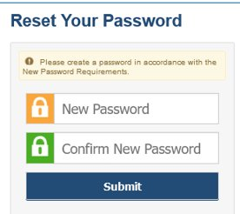
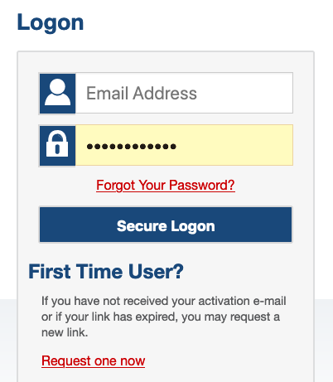
Creating IA TOMS Accounts
An email will be sent to the user with a link to create their password.
The TE will have 30 min. to click the link.
If the link expires, TEs can receive a new email by selecting Request one now from the TOMS logon screen.
Click here to receive a new email link.

Slide 32
Preparing for IA Administration
Accessibility Resources

Slide 33
California Assessment Accessibility Resource Matrix Designated Supports
Identify student's needs.
Match needs to available supports.
Use supports during instruction.
Use supports during IAs and practice and training tests.
Evaluate effectiveness of supports and finalize support selections.
Enter supports in TOMS for summative assessments.
Administer summative assessments.
Evaluate effectiveness of supports.

Slide 34
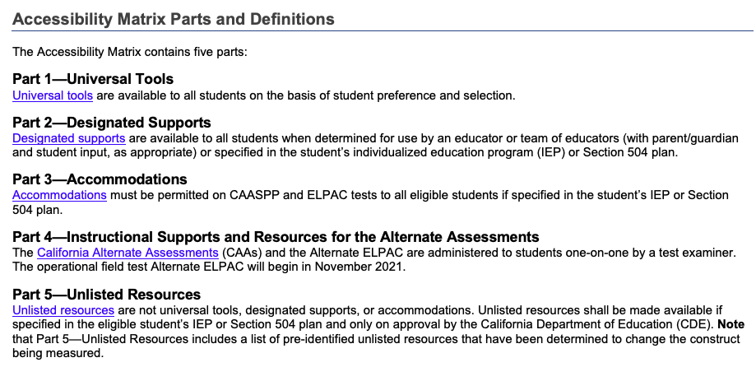
California Assessment Accessibility Resource Matrix
This matrix describes all the available accessibility resources for ELPAC and CAASPP.
Universal Tools, Designated Supports, and Accommodations
Accessibility resources are features or supports that are part of the assessment.
Accessibility resources allow students to participate in an assessment that results in a fair and accurate estimate of each student’s achievement.
https://www.cde.ca.gov/ta/tg/ca/accessibilityresources.asp

Slide 35
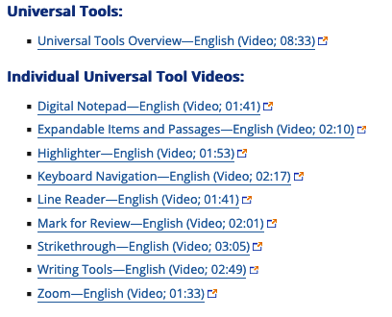
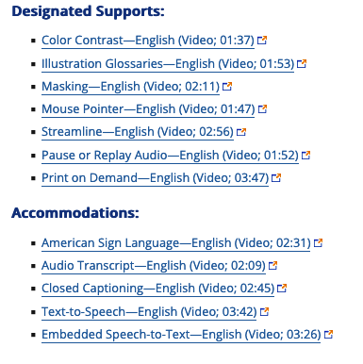
Accessibility Resources Demonstration Videos
The following link provides demonstrations of select universal tools, designated supports, and accommodations allowed as part of the ELPAC.
http://www.caaspp.org/training/caaspp/uaag.html
Beneficial for students, teachers, and IEP teams.
Available in Spanish.
Start reviewing with teachers now for Summative ELPAC administration!

Slide 36
Professional Development for Staff
Review Matrix and demonstration videos
Teachers will be prepared for Summative CAASPP
Accessibility Resources Virtual Training Series
Module A: Matching Accessibility Resources to Students' Needs
Module B: Using Accessibility Resources in Daily Instruction

Slide 37
Preparing for IA Administration
Student Logon Credentials

Slide 38
Student Logon Credentials
Student logon credentials include personally identifiable information (PII), which is secure and is protected by federal privacy laws.
Student’s First Name
The name must be typed exactly as it appears in TOMS
TOMS will indicate a Preferred Name if one was entered in MiSiS
Student’s SSID

Slide 39
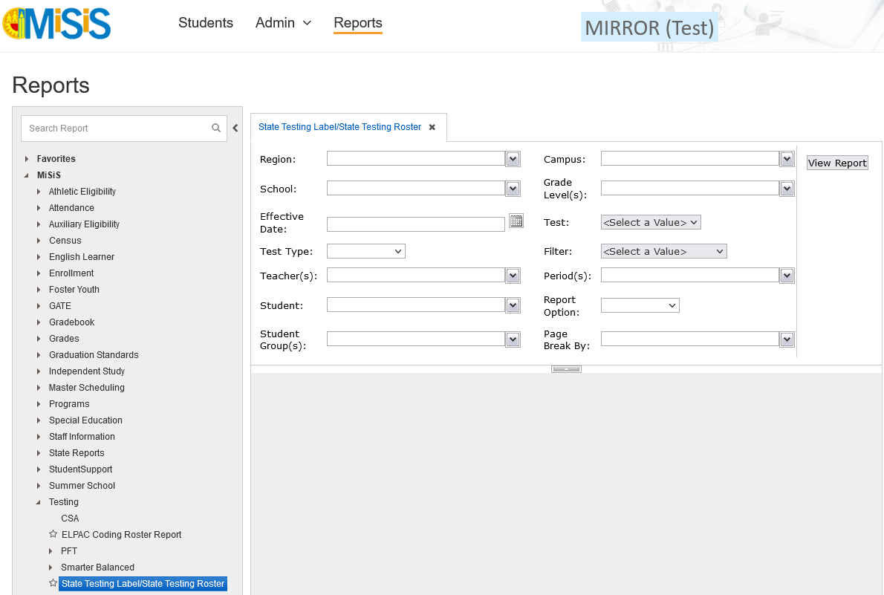
MiSiS Smarter Balanced Label & Student Rosters
3. Complete Fields
1. Reports
Coordinators will use their Categorical Coordinator Role to access labels and rosters. Request access from your Principal through oneAccess.
4. View Report
2. Testing > Student Testing Label/State Testing Roster

Slide 40
Test Security and Student Logon Credentials
Student logon credentials (i.e., SSID and Confirmation Code) are to be considered secure and confidential information that grant access to a student’s Personal Identifiable Information (PII).
Schools must establish procedures to maintain all student logon credentials secure by returning them to the ELPAC Coordinator at the end of testing each day.
Schools must train all staff that will be handling student logon credentials on the established procedures and guidelines for maintaining the security of student logon credentials
Schools are to report to the Student Testing Branch if student logon credentials are compromised.
Notes:
Daily Inventory Control Forms should be prepared ahead of time and used when checking in/out materials for testing each day.

Slide 41
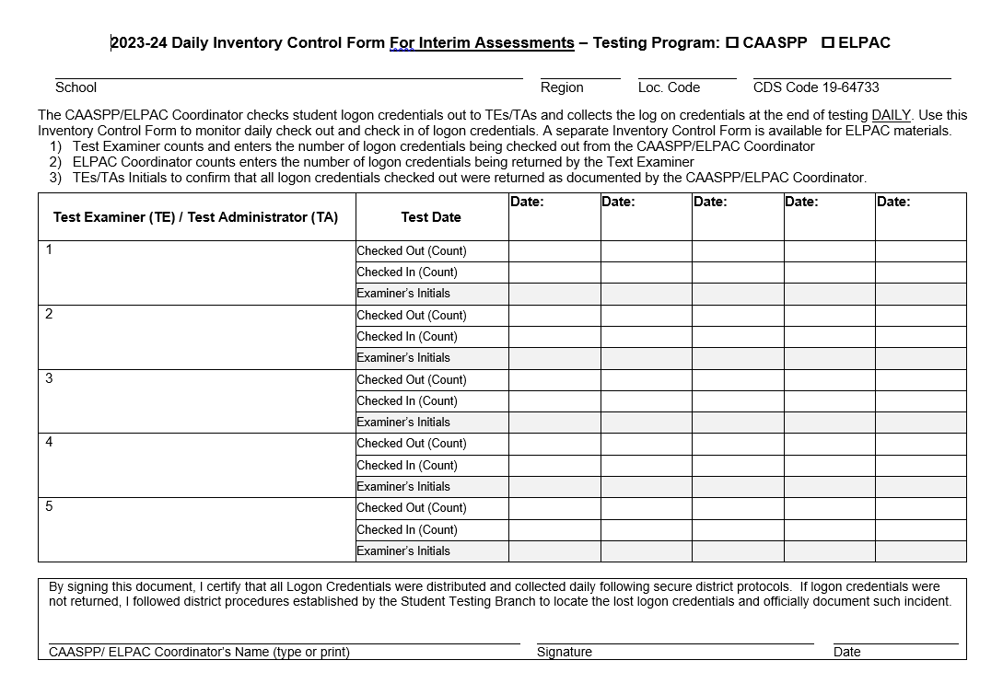
Daily Inventory Control Form for Interim Assessments
Interim Assessment Administrators will check out/in the following materials each day of testing using the Interim Assessment Daily Inventory Control Form:
Student Logon Credentials
Scratch paper
Located in Coordinator Resources
Notes:
Daily Inventory Control Forms should be prepared ahead of time and used when checking in/out materials for testing each day. This form is certified by the ELPAC Coordinator and may be requested in an audit or for post test documentation.

Slide 42
Preparing for IA Administration
Technology

Slide 43
Systems Needed for ELPAC IAs
Test Operations Management System (TOMS)
Test Administrator (TA) Interface
Secure Browser
Teacher Hand Scoring System
Data Entry Interface

Slide 44
Operating Systems and Secure Browsers
Secure Browser v16 is now available through the Secure Browsers web page on the ELPAC website. Secure Browser v15 support will expire October 31, 2023.
MacOS​ | iOS​ | Chrome OS​ | Windows​
MacOS 11.6-13 ​ Secure Browser 15.0​ or 15.5 ​ ​ | iOS 15.4+​ Secure Browser v8​ | ChromeOS v102+​ ​ Secure Browser v8​ | Windows 10 21H2​ Secure Browser 15.0​ ​ ​
​ | ​ | ​ | ​
Check ca.portal.cambiumast.com for the latest updates

Slide 45
Technology For Test Administration
TE Device
Requires a mouse, touchpad, or touch screen.
A current version of one of the following web browsers:
Chrome
Firefox
Student Device
A computer or tablet with a microphone.
Requires a mouse, touchpad, or touch screen.
Tablet must have an external keyboard.
Secure Browser must be installed on the device.

Slide 46
IA Administration
Creating Test Sessions

Slide 47
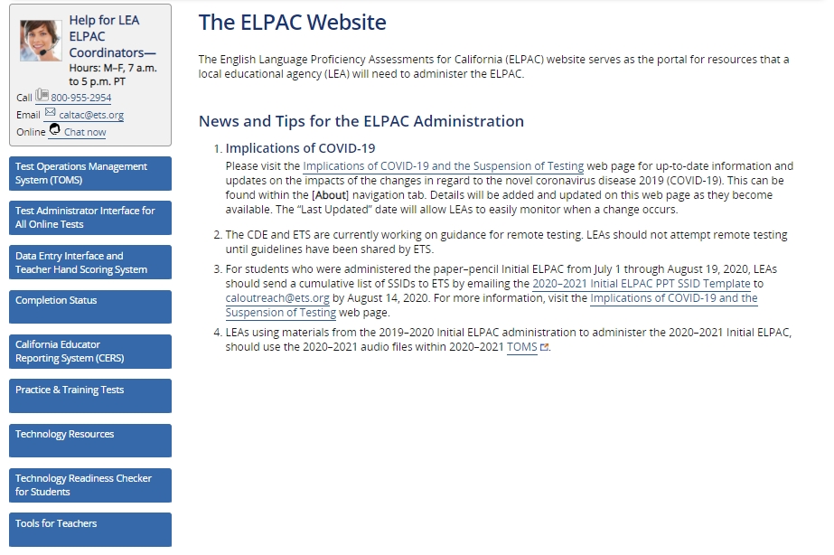
Creating a Test Session
The Test Session ID is created by the teacher in the Test Administrator Interface using their TOMS logon credentials.
The Session ID should be created just before students are to log into the test.
The Session ID should be posted so students can view it from their seat.

Slide 48
Creating a Test Session cont.
1

Slide 49
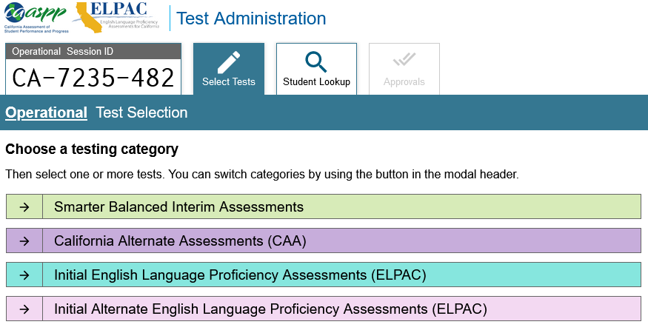
Creating a Test Session cont.
Session ID
ELPAC IAs will be available here by grade level and domain

Slide 50
Creating a Test Session cont.
In Person is the default.
Select Nonstandardized or Standardized/Benchmark

Slide 51
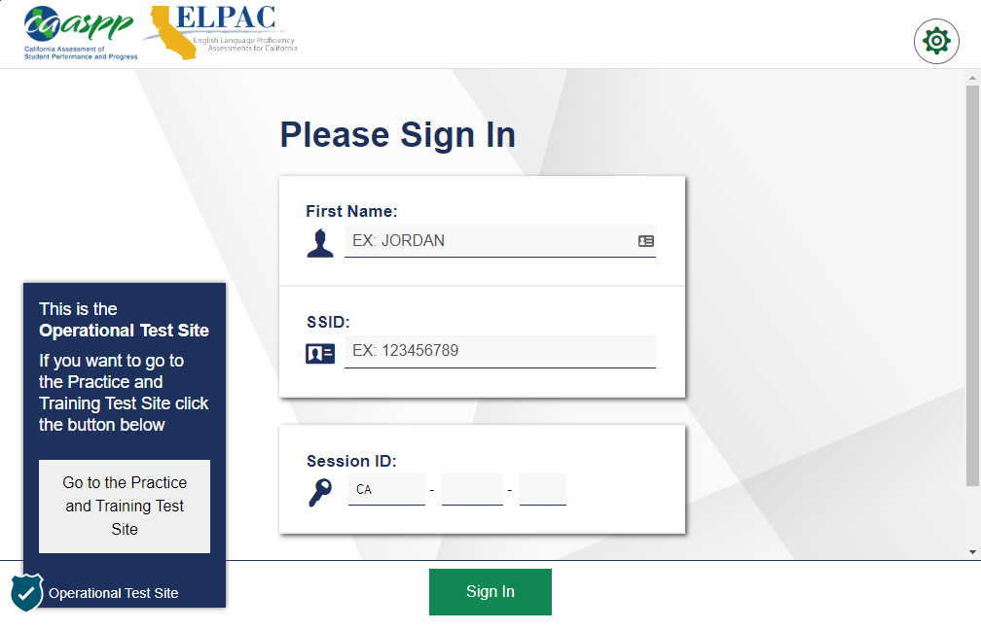
Student Logs Into the Test
The student’s logon credentials include the student’s personally identifiable information (PII), which is secure and is protected by federal privacy laws.

Slide 52
Assigning Accessibility Resources
The TA sets supports and accommodations at the time of testing.
Supports are NOT entered in TOMS
IA Administrators add supports BEFORE approving the student.

Slide 53
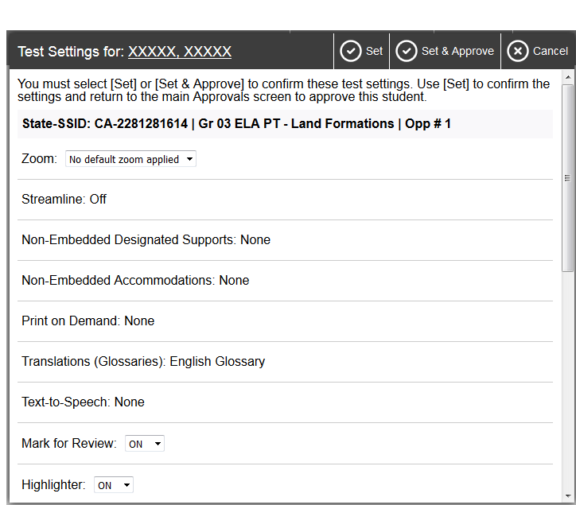
Creating a Test Session cont.

Slide 54
After Testing
Monitoring Test Completion

Slide 55
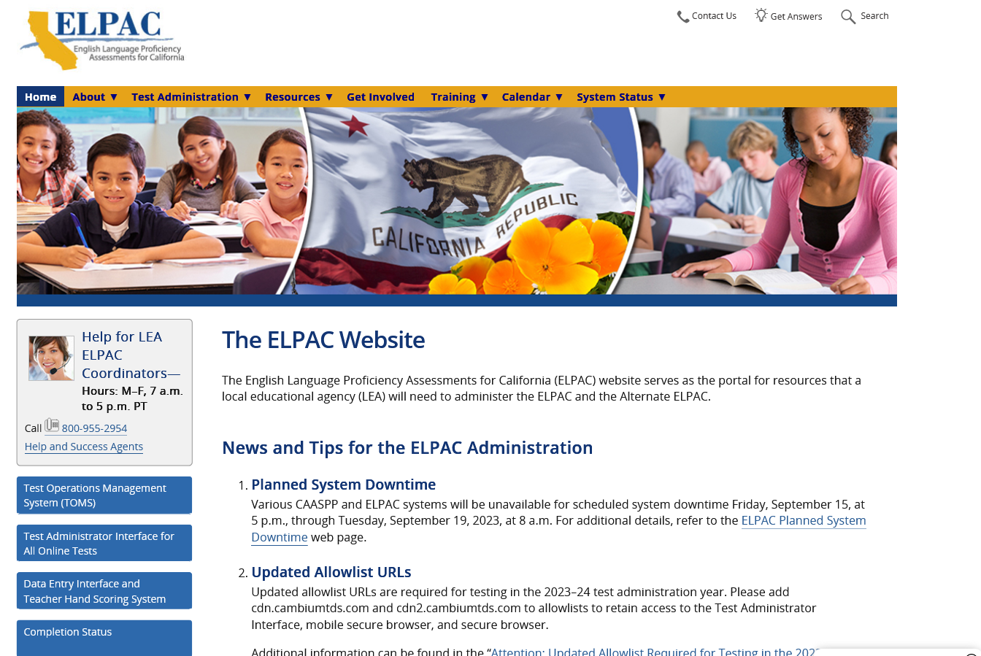
Completion Status
Completion Status
This Report provides the most accurate and up-to-date results
Monitor test completion status for ELPAC

Slide 56
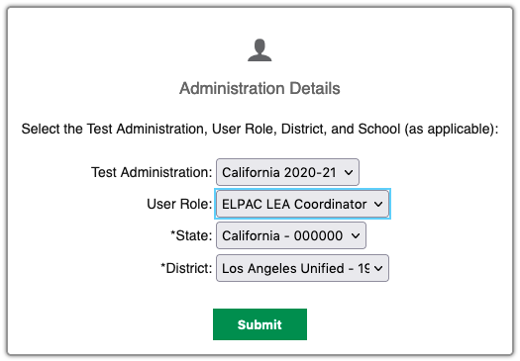
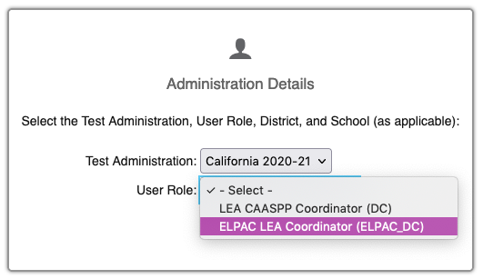
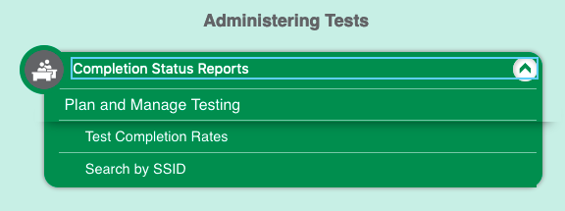
Plan and Manage Testing Report
1
2
3

Slide 57
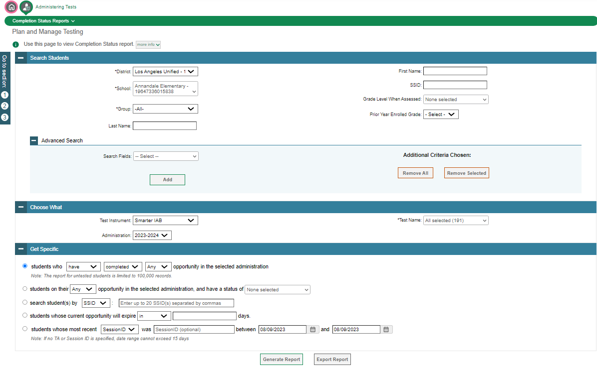
Plan and Manage Testing Report
Your school populates
1. Select Test
2. Select the first radio button: students who HAVE COMPLETED
3. Generate (View) or Export Report

Slide 58
After Testing
California Educator Reporting System (CERS)

Slide 59
California Educator Reporting System (CERS)
Assessment Name
Interim Assessments
English Language Proficiency Assessments for California (ELPAC)
Summative ELA and Mathematics
California Alternate Assessment (CAA) Summative ELA and Math
California Spanish Assessment (CSA)
California Science Test (CAST)
CAA Science
Alternate ELPAC

Slide 60
California Educator Reporting System (CERS) Cont.
Module 5a: Understanding the Reporting System
Module five consists of two demonstration videos for the California Educator Reporting System (CERS). The first demonstration video is designed for educator use and the second video is designed for administrator use.
This ten-minute video demonstrates how educators can use CERS to view item-, student-, and group-level assessment results data.
Access the Understanding the Reporting System for Educators or Understanding the Reporting System for Educators through the following link:
https://www.cde.ca.gov/ta/tg/sa/iavideoseries.asp

Slide 61
Action Item
Download the Interim Assessment by Grade Level and At a Glance documents and share with staff.
Become familiar with Interim Assessment Viewing System and the various uses of the system.
Become familiar with the steps and procedures for accessing and navigating the IA Hand Scoring System.
Prepare and facilitate the IA Training (if needed).
Verify the completion of the Acknowledgement Form in the STB Portal before creating IA TOMS Accounts.

Slide 62
Action Items to Complete With CAASPP Coordinator
Review Accessibility Resources Demonstration videos with TEs and plan Accessibility Resources PD for TEs.
Confirm that all student devices have Secure Browser downloaded according to the Supported Secure Browser Versions for Student Testing page.
Confirm TE web browsers (Chrome or Firefox) are updated.
Become familiar with the steps and procedures for accessing and navigating the IA Reporting System (CERS).

Slide 63
Support Contact Information
CDE Interim Assessments Web Page
http://www.cde.ca.gov/ta/tg/sa/sbacinterimassess.asp
ETS CAASPP Web Site
http://www.caaspp.org
Student Testing Branch
http://achieve.lausd.net/testing
213-241-4104
Division of Instruction
http://achieve.lausd.net/instruction#spn-content
213-241-5333
Division of Special Education
http://achieve.lausd.net/sped
213-241-6701

Slide 64
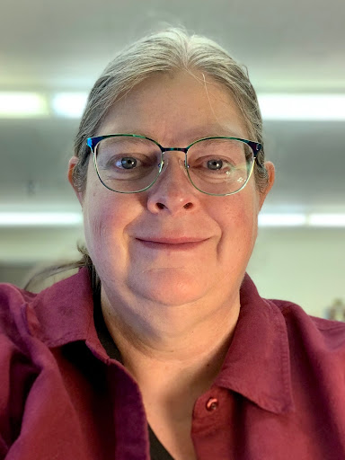
Region Data Coordinators
NORTH | SOUTH | EAST | WEST
Michele Parsons michele.parsons@lausd.net | Mario Apodaca mario.apodaca@lausd.net | Yolanda Campos yolanda.campos@lausd.net | Guadalupe Garibay gxg1959@lausd.net

Slide 65
Student Testing Branch
(213) 241-4104
7:30 am – 4:00 pm

